Slide 1
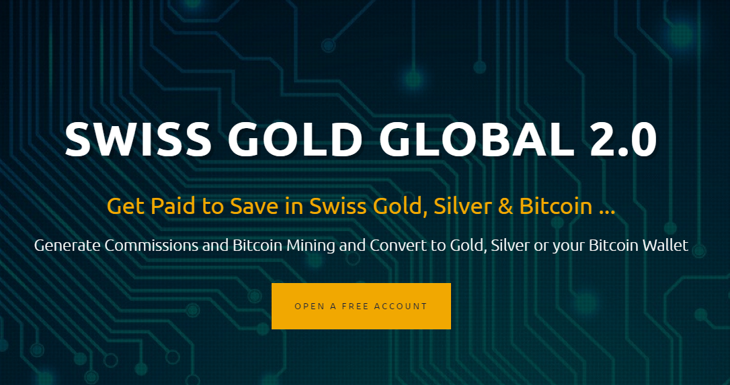

Slide 2
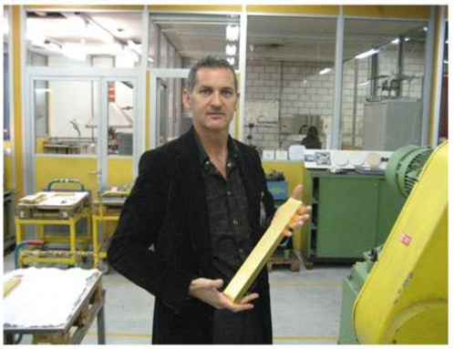
Founder & CEO Bill Rowell

Slide 3
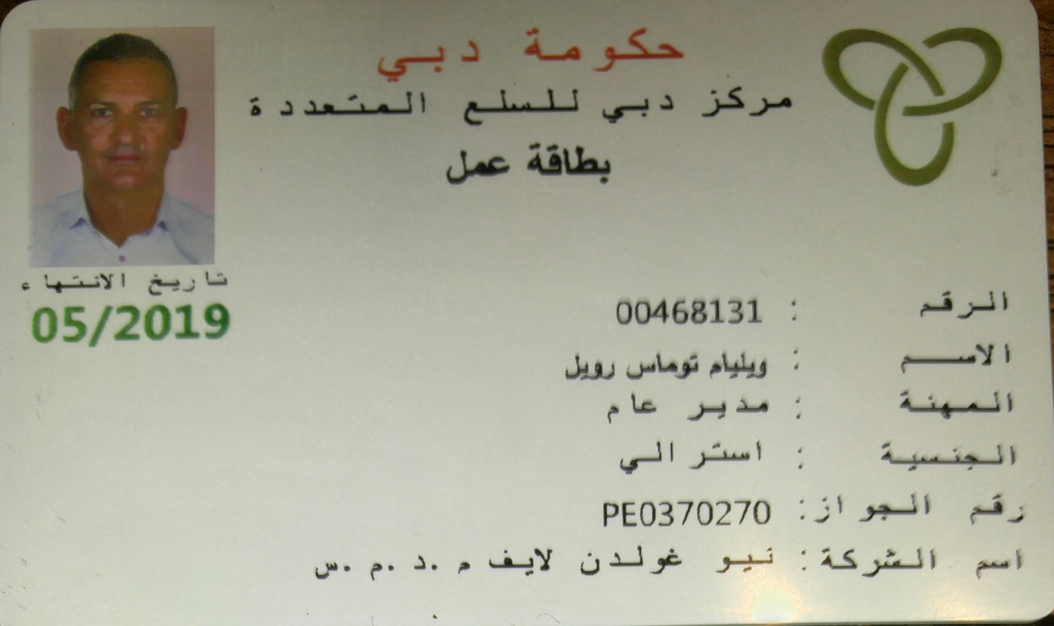
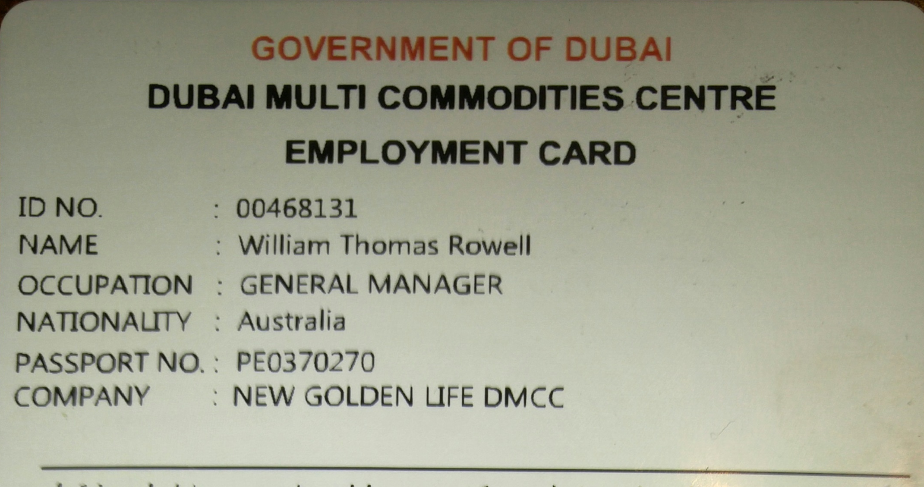

Slide 4
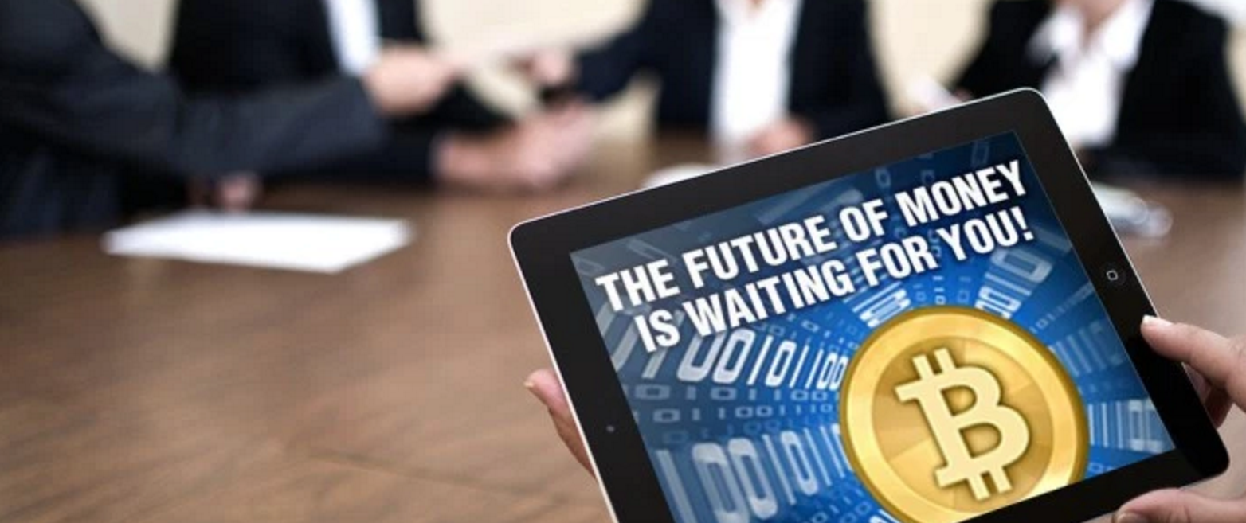
Today we will show you …
How to cash in from the Crypto Currency Trend
How to get PAID DAILY, WEEKLY & MONTHLY!
How to get PAID to SAVE in Swiss certified GOLD & SILVER
Inflation Proof Your Money

Slide 5
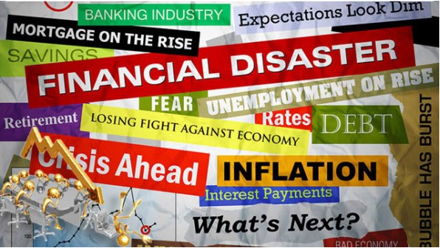
Our Changing World?

Slide 6
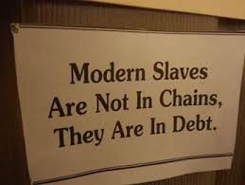
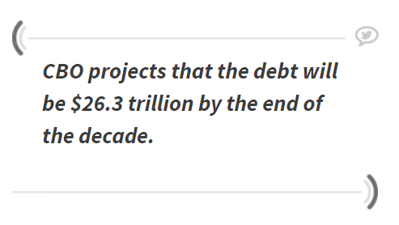
DEBT
Congressional Budget Office (CBO)
Last year, the U.S. spent $430 billion on interest payments alone

Slide 7
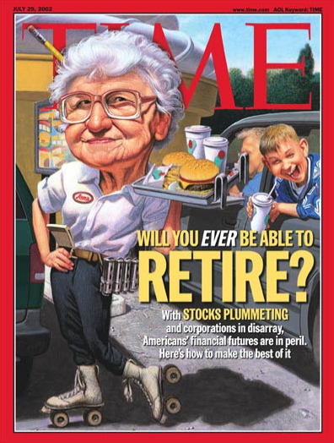
RETIREMENT
Fifty years ago, the average retirement was 12 years.
Someone retiring today at age 65 is expected to live to 85 or longer.

Slide 8
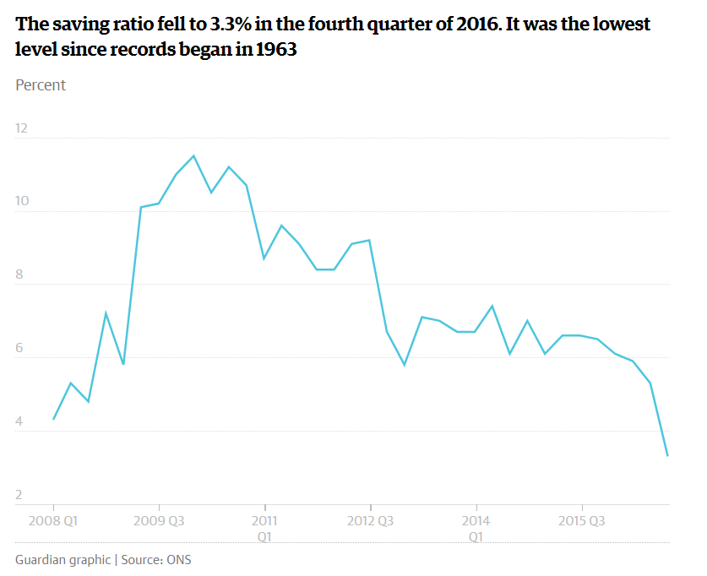

Slide 9
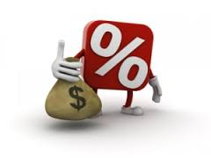
SAVINGS?
It is not realistic to finance a 30-year retirement with 30 years of work. You can’t expect to put 10% of your income aside and then finance a retirement that’s just as long.
—JOHN SHOVEN, Stanford University professor of economics

Slide 10
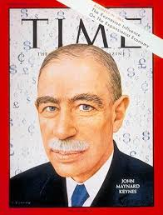
Why Gold, Silver, Bitcoin & Altcoins?
BY A CONTINUING PROCESS OF INFLATION, GOVERNMENTS CAN CONFISCATE, SECRETLY AND UNOBSERVED, AN
IMPORTANT PART OF THE WEALTH OF THEIR CITIZENS. THERE IS NO SUBTLER, NO SURER MEANS OF OVERTURNING
THE EXISTING BASIS OF SOCIETY THAN TO DEBAUCH THE CURRENCY.
THE PROCESS ENGAGES ALL THE HIDDEN FORCES OF ECONOMIC LAW ON THE SIDE OF DESTRUCTION, AND DOES IT IN A MANNER WHICH NOT ONE MAN IN A MILLION IS ABLE TO DIAGNOSE.
John Maynard Keynes, 1st Baron Keynes CB FBA, was an English economist whose ideas fundamentally changed the theory and practice of macroeconomics and the economic policies of governments.
British Economist (June 5, 1883- April 21, 1946

Slide 11
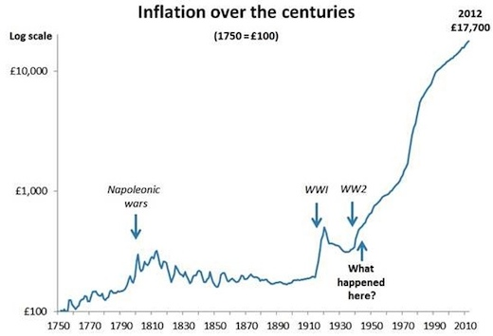

Slide 12
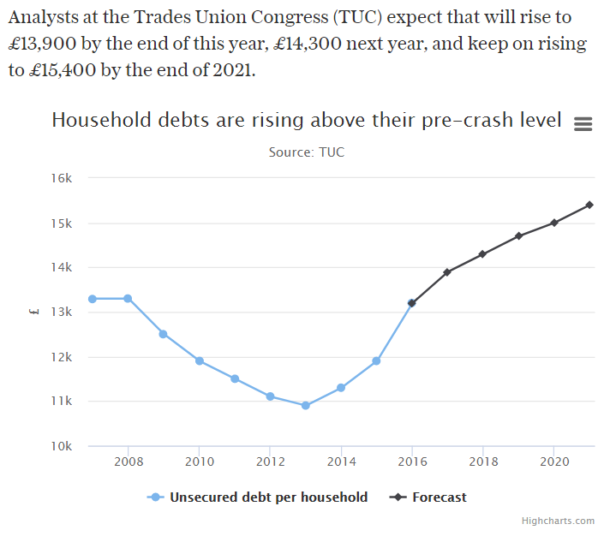

Slide 13
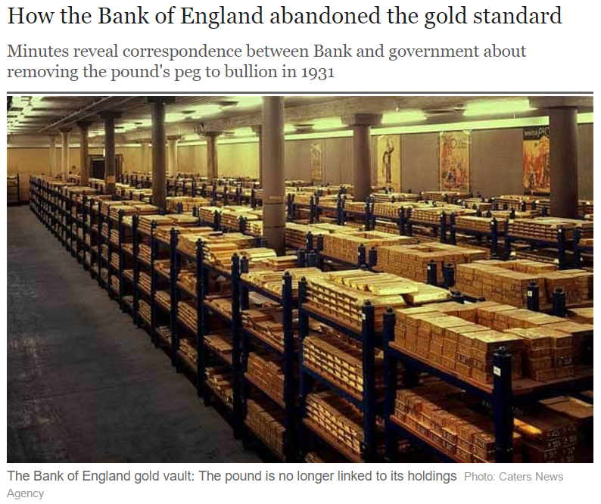

Slide 14
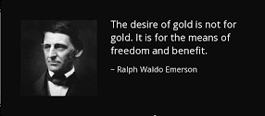
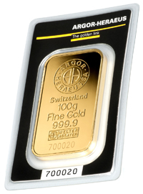
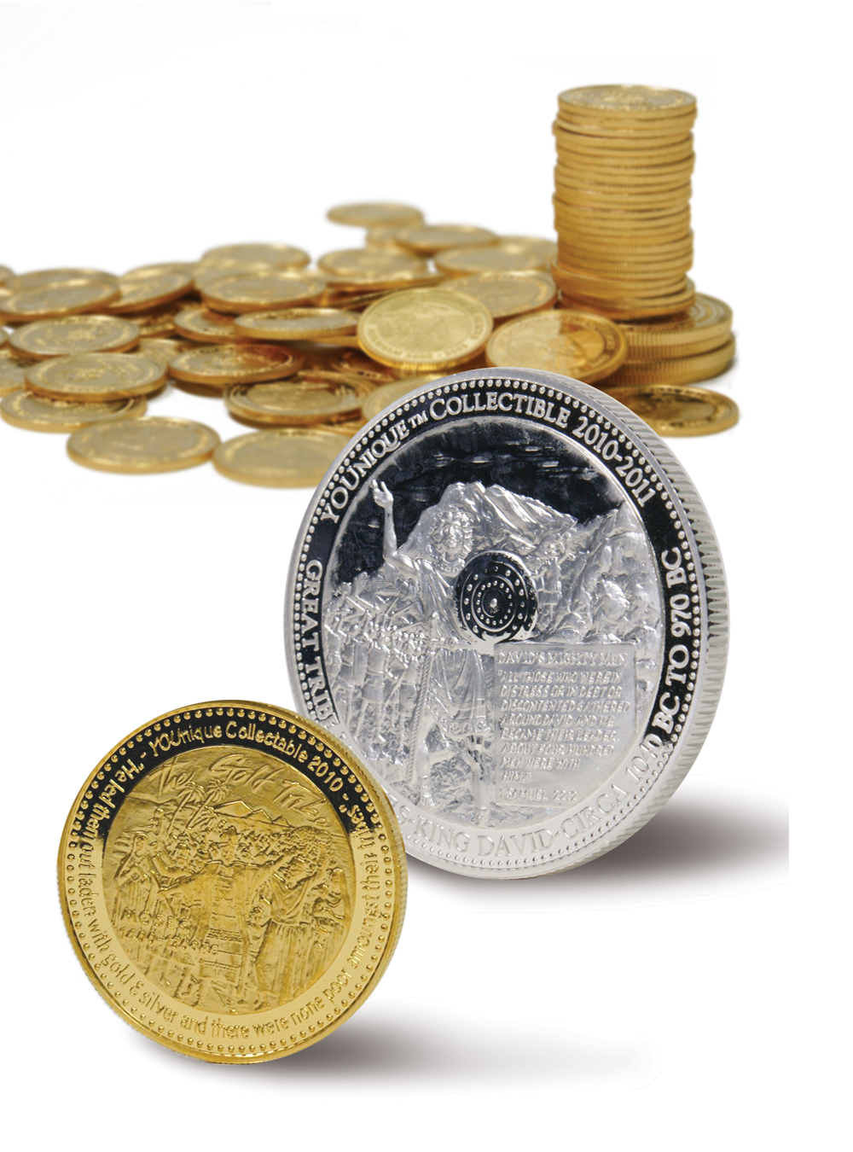
Why Bitcoin?

Slide 15
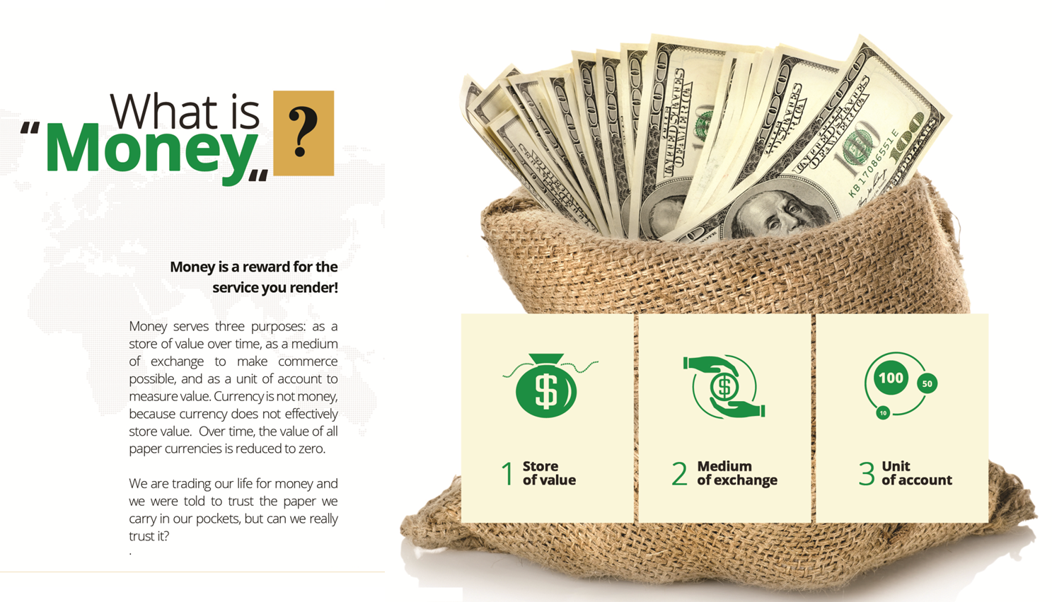

Slide 16
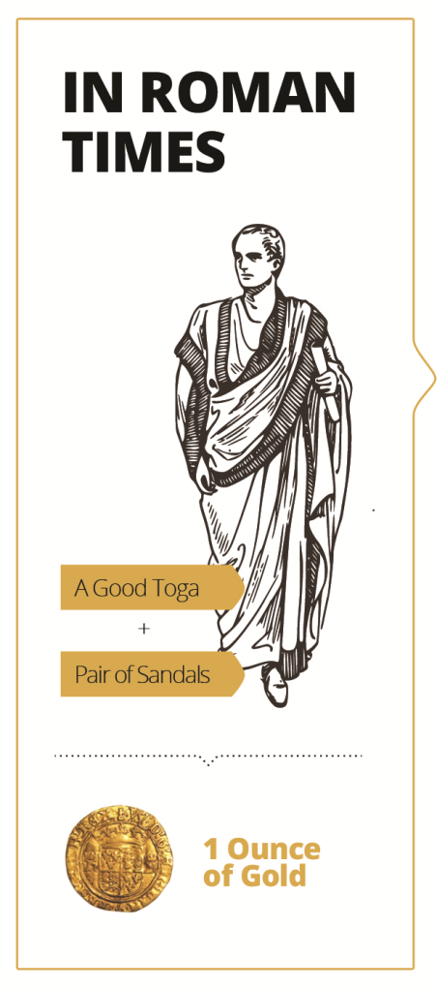
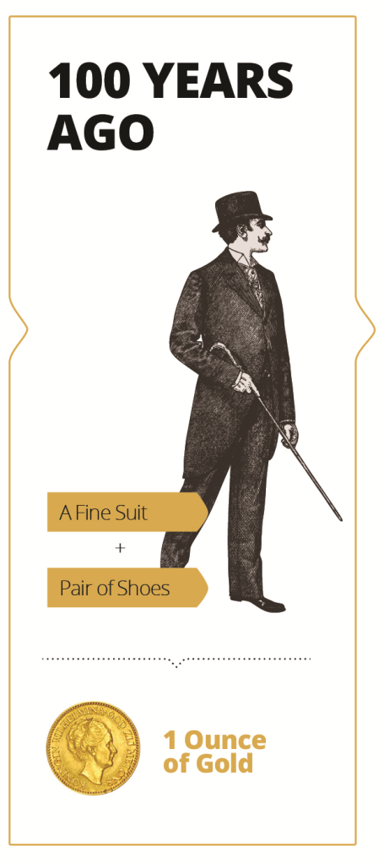
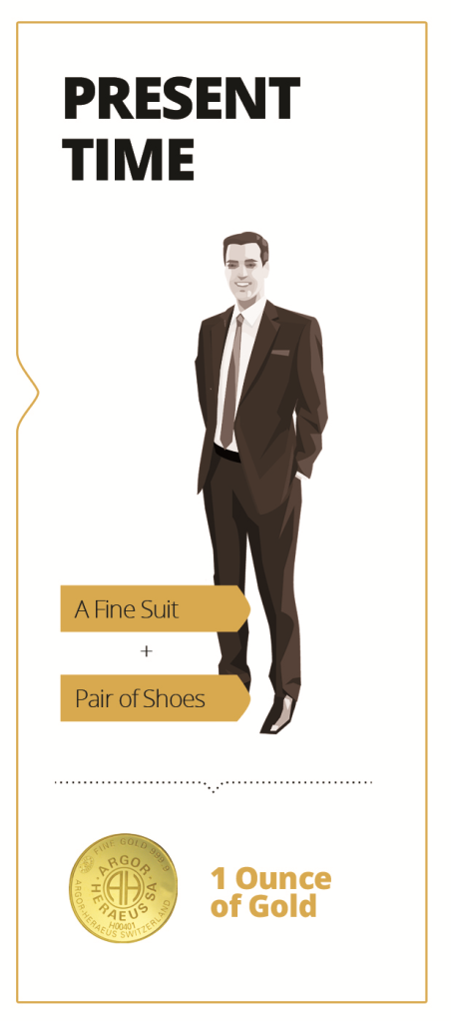
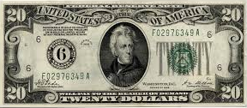
Why Gold?
Gold has held its value
for Thousands of years.
What matters is not the
“price” but is buying
power.

Slide 17
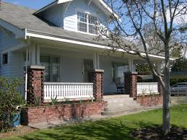
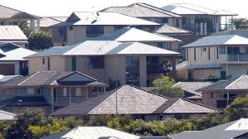
Gold is a true store of value!
1933 oz Gold $20.67
Medium average US house price: $5750.00 or
GOLD 278 oz
2017 oz Gold $1200
Medium average US house price: $257,200 or GOLD 214 oz

Slide 18
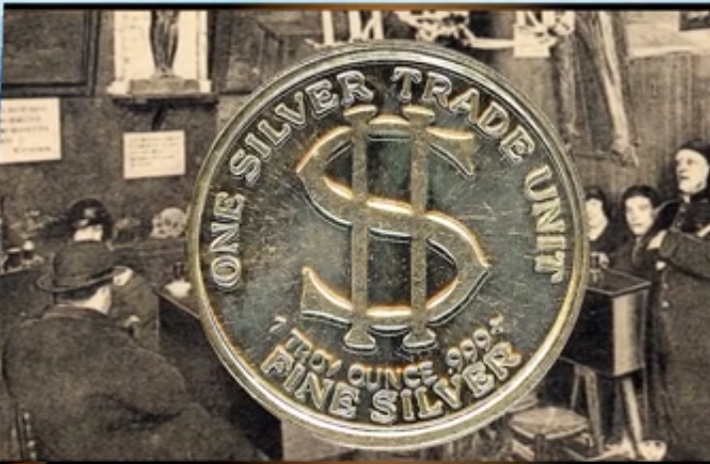
In 1920’s Ounce Silver priced at $0.67cents
& you could buy a good meal for 0.67cents
Today what will $0.67cents buy?
Today an ounce of silver will still buy you a great meal any where in the World!

Slide 19
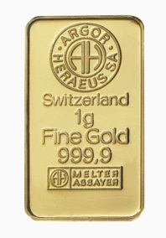
A need to GET this!
Year 2000 – Starbucks Coffee $1.00
Buys 1 Cup
Gold $279 oz - $9gram =
Buy 9 Cups
Year 2016 Starbucks price $4
Gold $1250 oz - $40gram=
Today Buy 9 Cups

Slide 22
How Are You Going To Do It?
GOALS

Slide 23
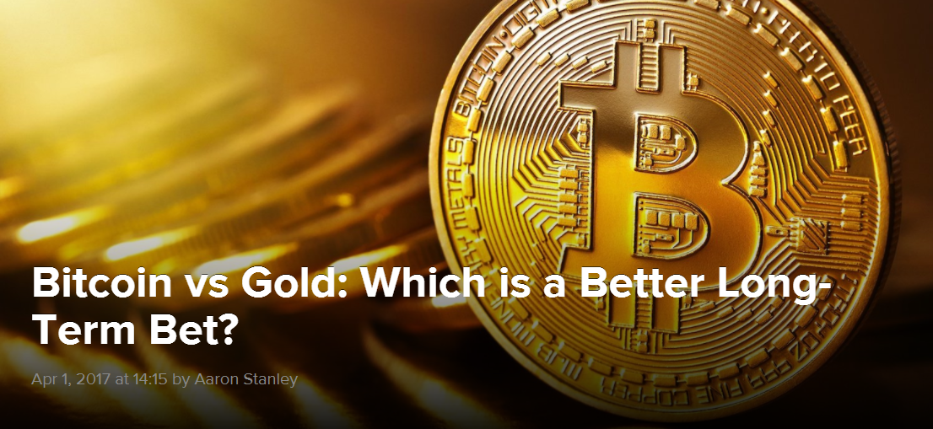

Slide 24
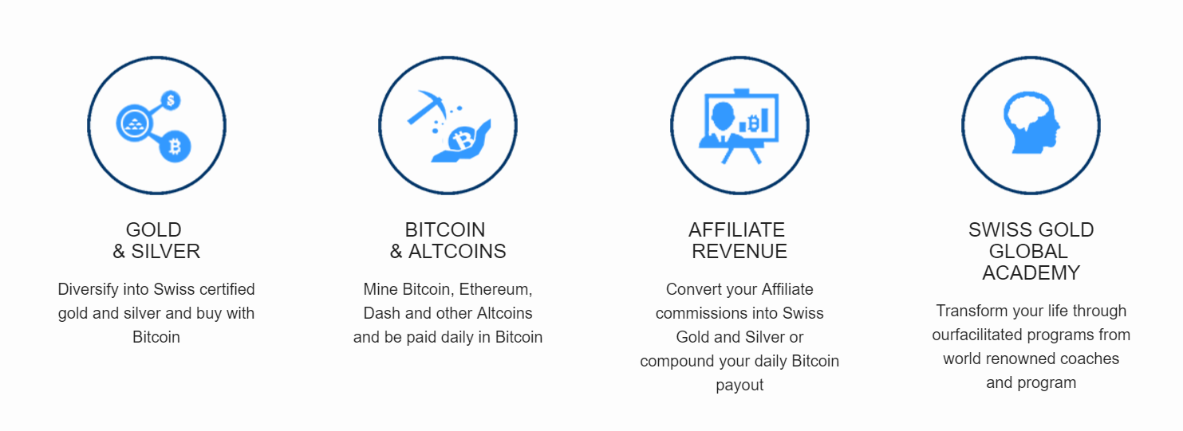
Get Paid to Save in Gold, Silver, Bitcoin daily payout and Affiliate Income

Slide 25
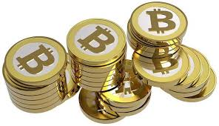
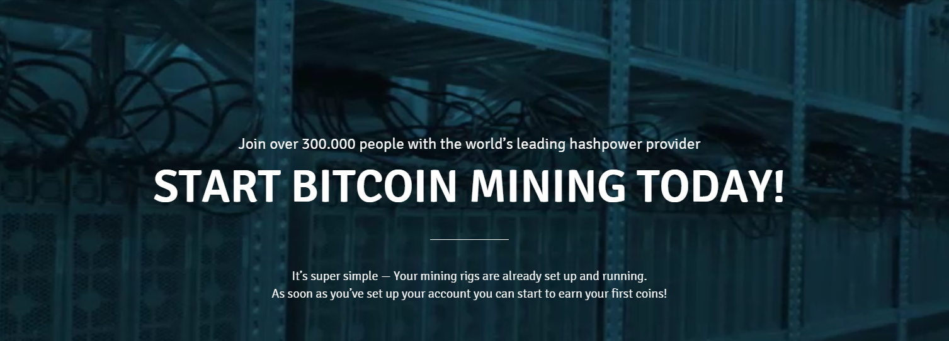
Daily Wallet Payout

Slide 26
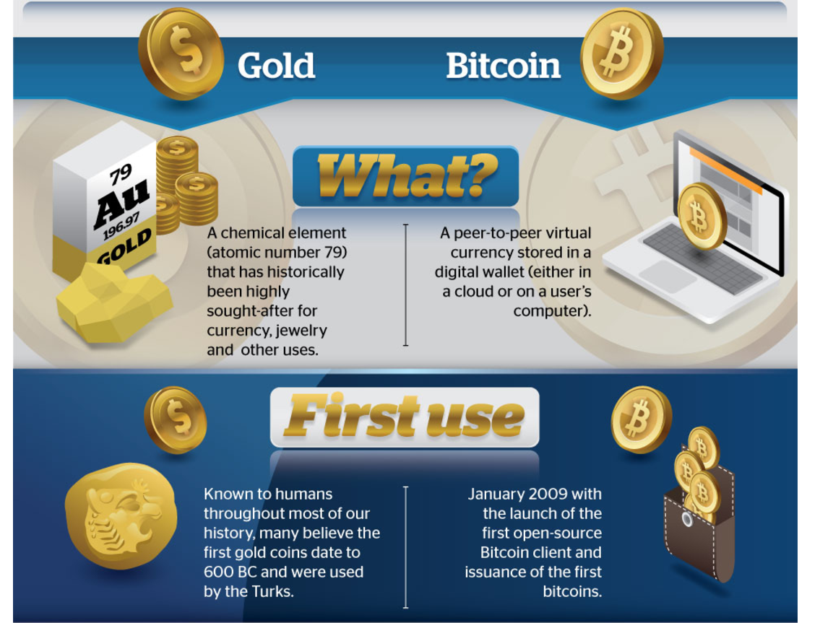

Slide 27
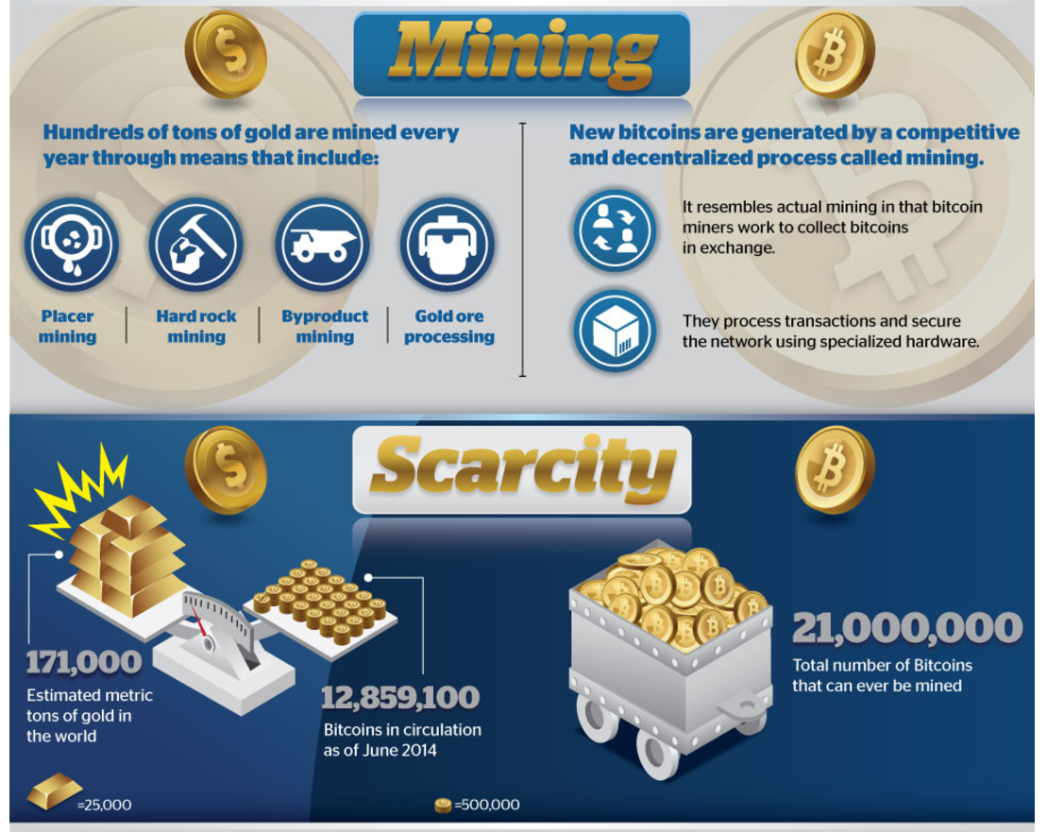

Slide 28
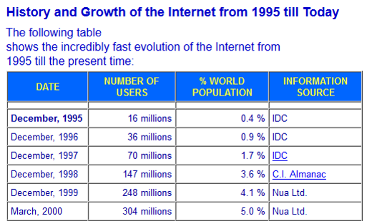
Global Trend …?

Slide 29
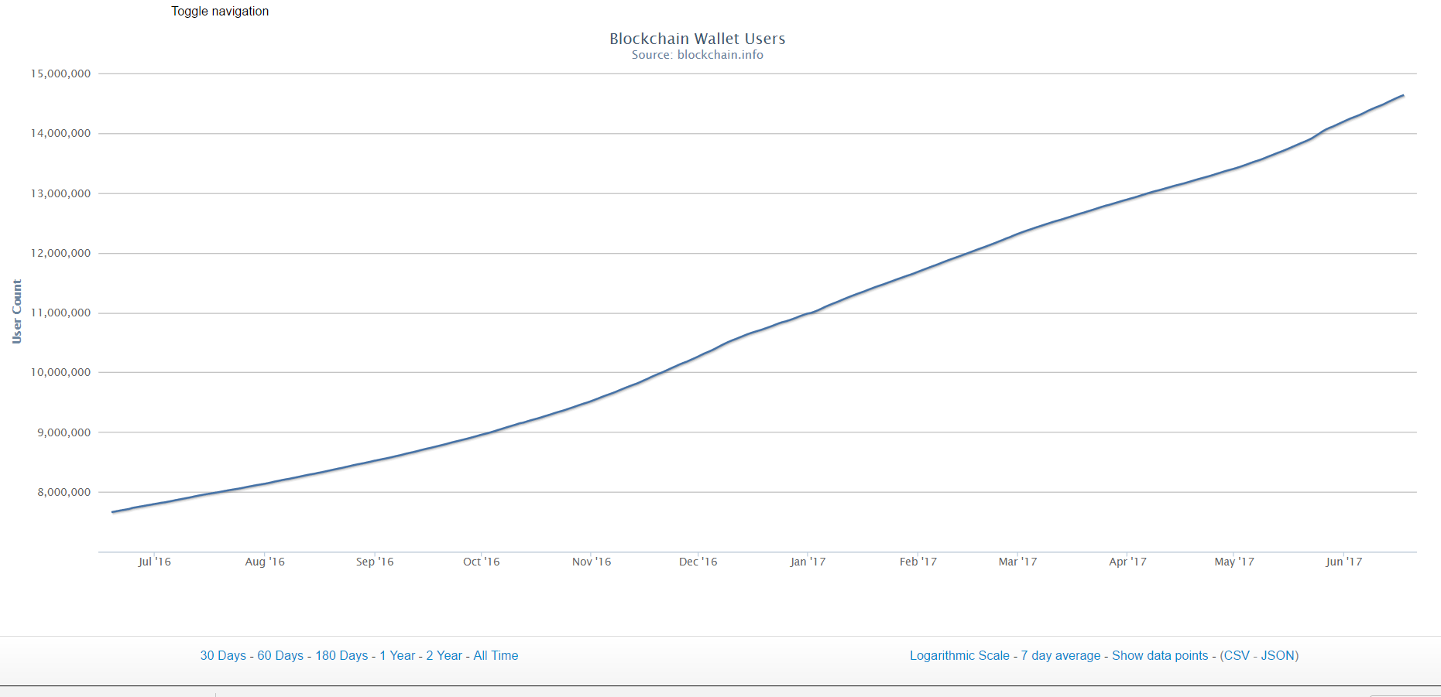
Expanding Market …

Slide 30
I want to get started …
What are the options?
Free Account
Miner $170 BTC package plus $50 month
Silver $249 gold / silver / BTC package plus $50 month
Gold $797/BTC package – one time
Executive Miner $3000 BTC package – one time
Ambassador $3000 gold / silver / BTC package – one time
Platinum $5000 gold / silver / BTC package – one time
Buy Swiss Gold Silver Wholesale 2.97%
Swiss Gold, Silver, Bitcoin & Altcoin Mining, daily, weekly, monthly Affiliate payout

Slide 31
1. Free Member Account
Free Account
Buy Bitcoin, DASH, Litecoin or Ethereum Mining Hash Power
Buy Swiss certified gold & silver at wholesale price
Earn 2.5% Bitcoin, DASH, Litecoin or Ethereum Mining Hash Power on all 1st level Customers
Buy Swiss Gold Silver Wholesale 2.97%

Slide 32
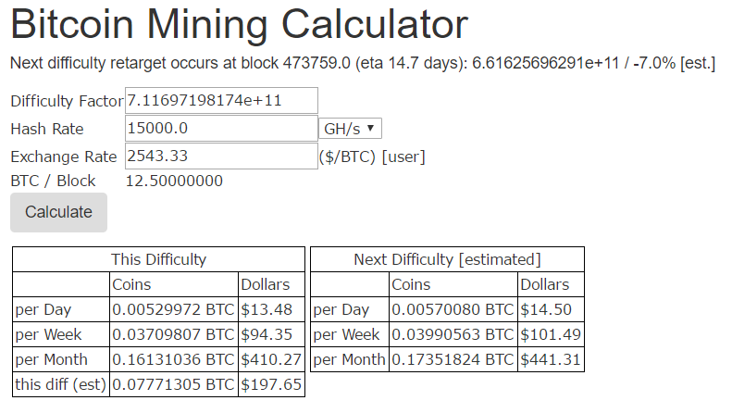
$1950 BTC open ended contract

Slide 33
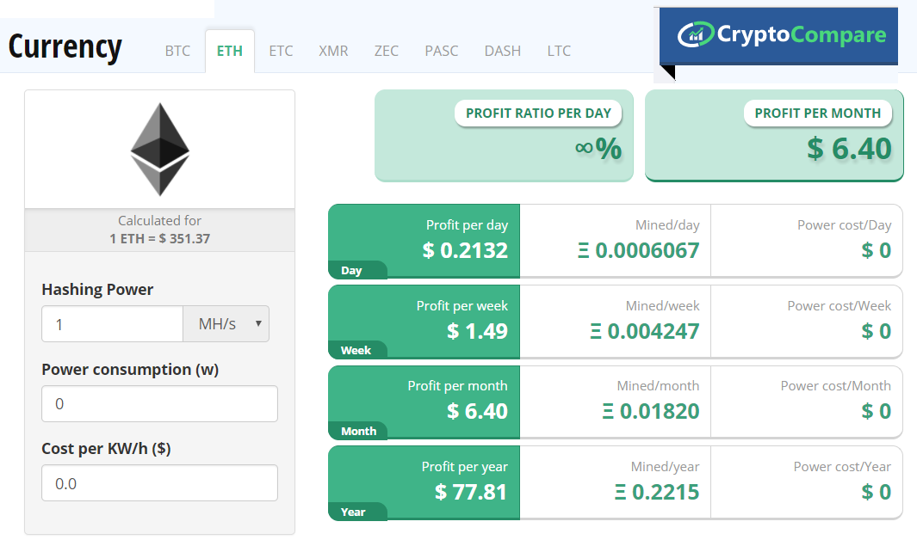
$29.99 - 2 year ETH contract

Slide 34
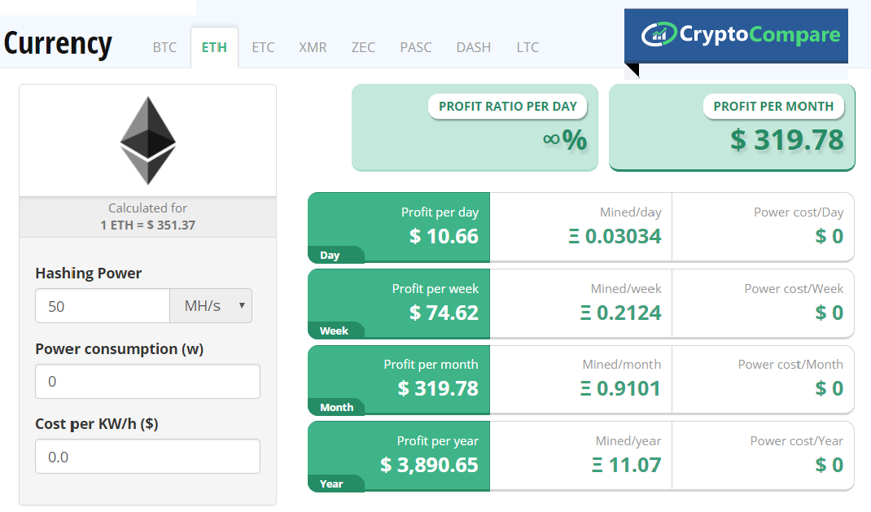
$1499.50 - 2 year ETH contract

Slide 35
$2799 - 2 year ETH contract

Slide 36
Free Member Affiliate Payout?
Free Account
5% Bitcoin, DASH, Litecoin or Ethereum Mining Hash Power on all Customers purchases
2.5% Bitcoin, DASH, Litecoin or Ethereum Mining Hash Power on all Customers 1st level Customers
Free Member: 2.5% Bitcoin, DASH, Litecoin or Ethereum Mining Hash Power on all 1st level Customers
1% bonus on gold, silver Customer purchases
Buy Swiss Gold Silver Wholesale 2.97%

Slide 37
2. Bitcoin Miner $170 package
Miner $170 BTC package - $50 month
Gold, Silver, Crypto Exchange 2.0
200GH/S Bitcoin Mining
Daily Payout* *Approx 5% return BTC $2479 Sponsoring NOT necessary to be PAID daily BTC Mining Payout
Monthly Membership 100GH (> year 35%)
Swiss Gold & Silver Wholesale 2.97%
Sell Back – No fees*
Swiss and Dubai Free LBMA storage *
Physical delivery (Authorised Countries)
Premium Education Program
Buy Swiss Gold Silver Wholesale 2.97%

Slide 38
Bitcoin Miner package payout
Miner $170 BTC package plus $50 month
$45 commissions
11 GH Bitcoin Mining Hash Power
Single Purchase orders:
5% Bitcoin, DASH, Litecoin or Ethereum Mining Hash Power on all Customers purchases
2.5% Bitcoin, DASH, Litecoin or Ethereum Mining Hash Power on all Customers 1st level Customers
1% on gold, silver Customer purchases

Slide 39
3. Silver $249 package
$249 package - $50 month
Gold, Silver, Crypto Exchange 2.0
$50 Swiss Gold and or Silver
200GH/S Bitcoin Mining
Daily Payout* *Approx 5% return BTC price $2479 Sponsoring NOT necessary to be PAID daily BTC Mining Payout
Monthly Membership 25% silver
Swiss Gold & Silver Wholesale 2.97%
Sell Back – No fees*
Swiss and Dubai Free LBMA storage *
Physical delivery (Authorised Countries)
Premium Education Program
Buy Swiss Gold Silver Wholesale 2.97%

Slide 40
Affiliate Silver package payout
3. Silver $249 gold / silver / BTC package
$70 commissions
50 GH Bitcoin Mining Hash Power
Single Purchase orders:
5% Bitcoin, DASH, Litecoin or Ethereum Mining Hash Power on all Customers purchases
2.5% Bitcoin, DASH, Litecoin or Ethereum Mining Hash Power on all Customers 1st level Customers
1% on gold, silver Customer purchases

Slide 41
4. Gold $797 package
Gold $797 package
Gold, Silver, Crypto Exchange 2.0 annual membership
$150 Swiss Gold and or Silver
500GH/S Bitcoin Mining
Daily Payout* *Approx 13% return BTC price $2479 Sponsoring NOT necessary to be PAID daily BTC Mining Payout
Swiss Gold & Silver Wholesale 2.97%
Sell Back – No fees*
Swiss and Dubai Free LBMA storage *
Physical delivery (Authorised Countries)
Premium Education Program

Slide 42
Gold Package Affiliate payout
4. Gold $797/BTC package
$145 commissions
100 GH Bitcoin Mining Hash Power
Single Purchase orders:
5% Bitcoin, DASH, Litecoin or Ethereum Mining Hash Power on all Customers purchases
2.5% Bitcoin, DASH, Litecoin or Ethereum Mining Hash Power on all Customers 1st level Customers
1% on gold, silver Customer purchases

Slide 43
5. Ambassador $3000 package
Ambassador $3K package
Gold, Silver, Crypto Exchange 2.0 annual membership
$800 Swiss Gold and or Silver
5000GH/S Bitcoin Mining
Daily Payout* *Approx 27% return BTC price $2497 Sponsoring NOT necessary to be PAID daily BTC Mining Payout
Swiss Gold & Silver Wholesale 2.97%
Sell Back – No fees*
Swiss and Dubai Free LBMA storage *
Physical delivery (Authorised Countries)
Premium Education Program

Slide 44
Ambassador package Affiliate payout
3. Ambassador $3K Gold / Silver / BTC package
$390 commissions
1000 GH Bitcoin Mining Hash Power
Single Purchase orders:
5% Bitcoin, DASH, Litecoin or Ethereum Mining Hash Power on all Customers purchases
2.5% Bitcoin, DASH, Litecoin or Ethereum Mining Hash Power on all Customers 1st level Customers
1% on gold, silver Customer purchases

Slide 45
6. Executive Miner $3000 package
Executive Miner $3K package
Gold, Silver, Crypto Exchange 2.0 annual membership
11000GH/S Bitcoin Mining
Daily Payout* *Approx 60% return BTC price $2497 Sponsoring NOT necessary to be PAID daily BTC Mining Payout
Swiss Gold & Silver Wholesale 2.97%
Sell Back – No fees*
Swiss and Dubai Free LBMA storage *
Physical delivery (Authorised Countries)
Premium Education Program

Slide 46
Executive Miner package Affiliate payout
6. Ambassador $3000 Gold / Silver / BTC package
$390 commissions
1500 GH Bitcoin Mining Hash Power
Single Purchase orders:
5% Bitcoin, DASH, Litecoin or Ethereum Mining Hash Power on all Customers purchases
2.5% Bitcoin, DASH, Litecoin or Ethereum Mining Hash Power on all Customers 1st level Customers
1% on gold, silver Customer purchases
Ambassador Leadership Package qualified*

Slide 47
7. Platinum $5000 package
Platinum $5K package
Gold, Silver, Crypto Exchange 2.0 annual membership
$1200 Swiss Gold and or Silver
15000GH/S Bitcoin Mining
Daily Payout* *Approx 90% return BTC price $2497 Sponsoring NOT necessary to be PAID daily BTC Mining Payout
Swiss Gold & Silver Wholesale 2.97%
Sell Back – No fees*
Swiss and Dubai Free LBMA storage *
Physical delivery (Authorised Countries)
Premium Education Program

Slide 48
Platinum package Affiliate payout
7. Platinum $5000 gold / silver / BTC package
$590 commissions
3000 GH Bitcoin Mining Hash Power
Single Purchase orders:
5% Bitcoin, DASH, Litecoin or Ethereum Mining Hash Power on all Customers purchases
2.5% Bitcoin, DASH, Litecoin or Ethereum Mining Hash Power on all Customers 1st level Customers
1% on gold, silver Customer purchases
Ambassador Leadership package qualified*

Slide 49
If you Team up with us you:
Get daily Bitcoin payout through Bitcoin & Altcoin Mining
Earn immediate income − from Fast Start Bonus
Get Affiliate income from Building a Network
Preserve Real Wealth through ownership of Swiss certified pure Gold and Silver
Compound your Bitcoin daily payouts

Slide 50
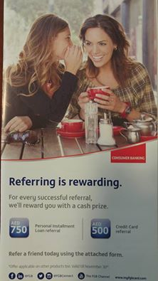
Financial Independence requires:
1) Residual Income
2) Leverage (of Time and Money)
3) Duplication
4) Wealth Preservation
5) Right Sector Right Time
“I would rather earn 1% off a 100 people’s efforts than 100% of my own efforts.”
– John D. Rockefeller, Businessman

Slide 51
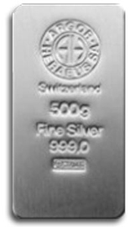
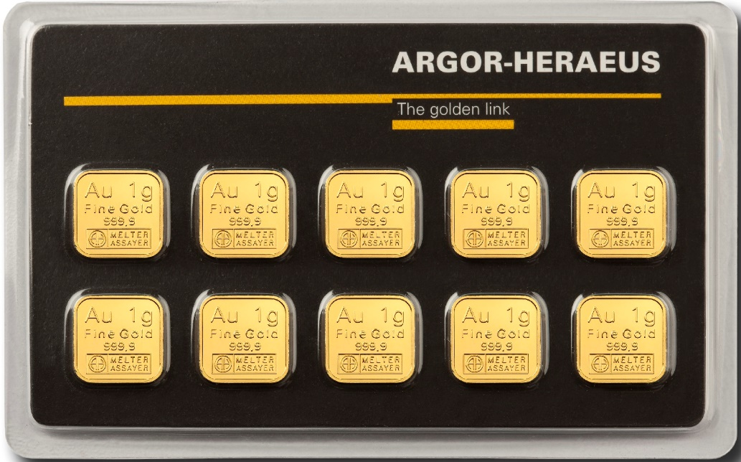
Fast Track 5 - Earn $275.00 - $2500.00
Monthly Uni – Level Package Payout … $37.50 plus $13 silver Break Even
2 LEVEL $225.00 Monthly
3 LEVEL $537.50 Monthly
4 LEVEL $2,100 Monthly
6 LEVEL $9,912.50 Monthly
6 LEVEL $48,975 Monthly
7 Financial Independence

Slide 52
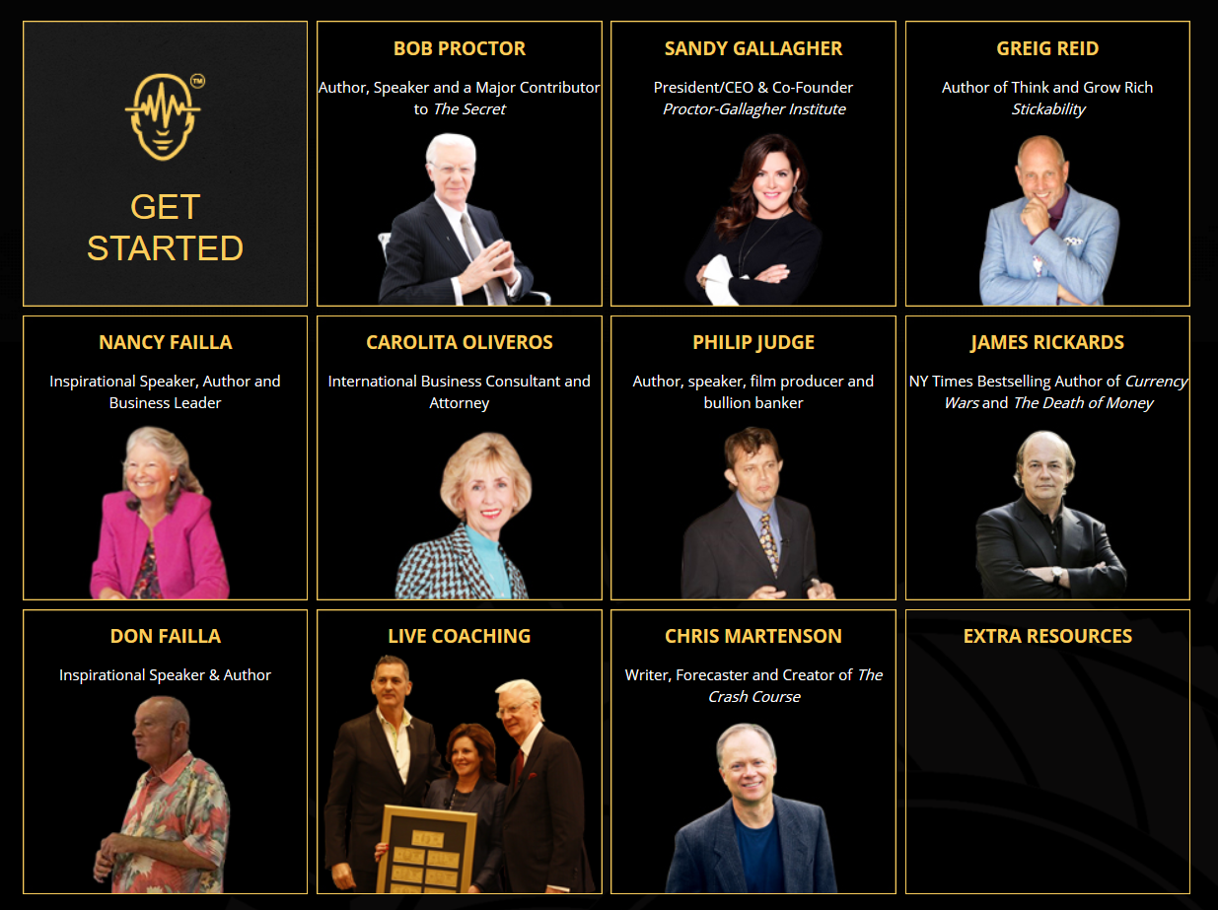

Slide 53
THERE IS NO GUARANTEE THAT YOU WILL EARN ANY MONEY USING THE TECHNIQUES AND IDEAS DISPLAYED. THESE MATERIALS ARE NOT TO BE INTERPRETED AS A PROMISE, FINANCIAL ADVICE OR A GUARANTEE OF EARNINGS. *BITCOIN & ALTCOIN DAILY PAYOUT WILL VARY DEPENDING UPON BUT NOT LIMITED TO PRICE, DIFFICULTY RATE, INDEPENDENT MINING COMPANIES OPERATIONAL EXPENSES & CONTRACT LIFE.

Slide 54
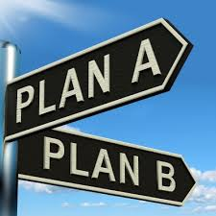
If You Want to Build Cash Flow and Be Paid To Save in Gold, Silver & Bitcoin …
Your Next Step:
TEAM UP …
Join Us and Get Started

Slide 55
Swiss Gold Global 2.0

Slide 56
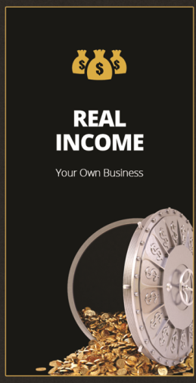
Fast Track 5 - Earn $275.00 - $2500.00
Annual Package Uni- Level Payout
Level 1 - $450.00
Level 2 - $2700.00
Level 3 - $6450.50
Level 4 - $25,200
Level 5 - $118,950
Level 6 - $587,700
Level 7 - Financial Independence

